Slide 1
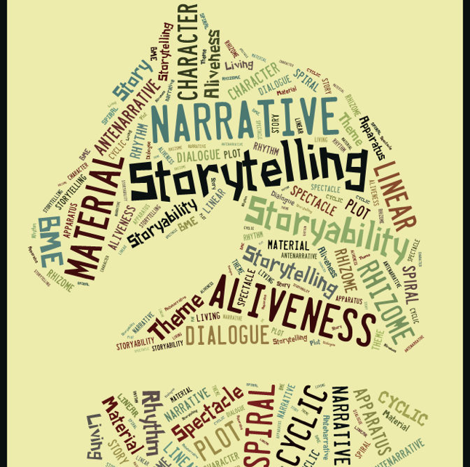
David Boje’s
Aalborg University
Slides are at https://antenarrative.com
16 November: Alborg Time (14.30-18-15) is ☺ (6:30-10:30 AM Mountain Time
Lecture. Storytelling and business modeling, on zoom (David M. Boje).
AGENDA
1. Socratic Method → Kierkegaard
2. The Four ♥’s of Storytelling & 7 Antenarrative Processes
3. The Four Who-Consciousness of Storytelling
4. Amendments to Business Ethics

Slide 2
MAIN QUESTION FOR THIS SEMINAR
Where’s the Ethics in
Business Modeling?

Slide 3
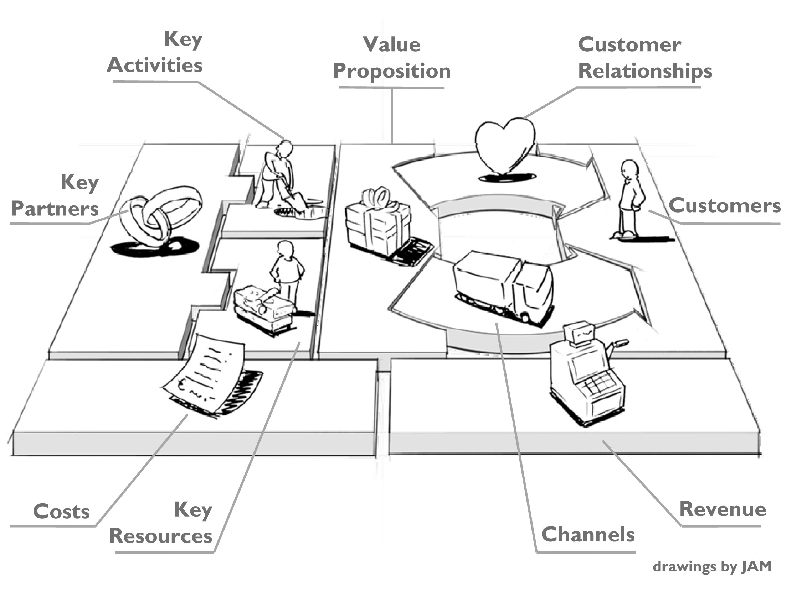
Business Model Generation
Discussion
Where’s the ETHICS in Business Modeling?

Slide 4
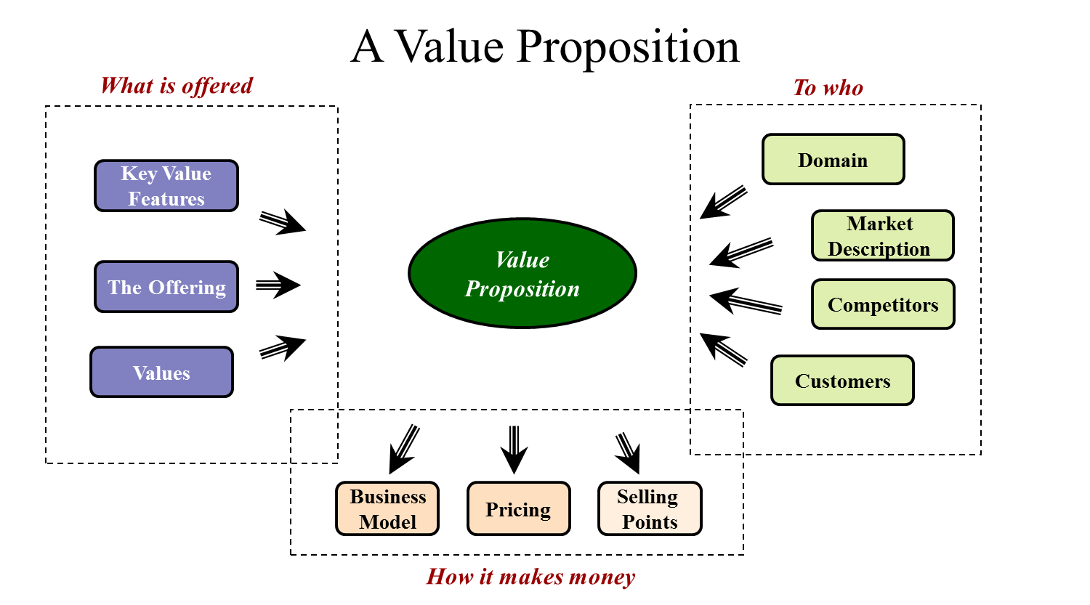
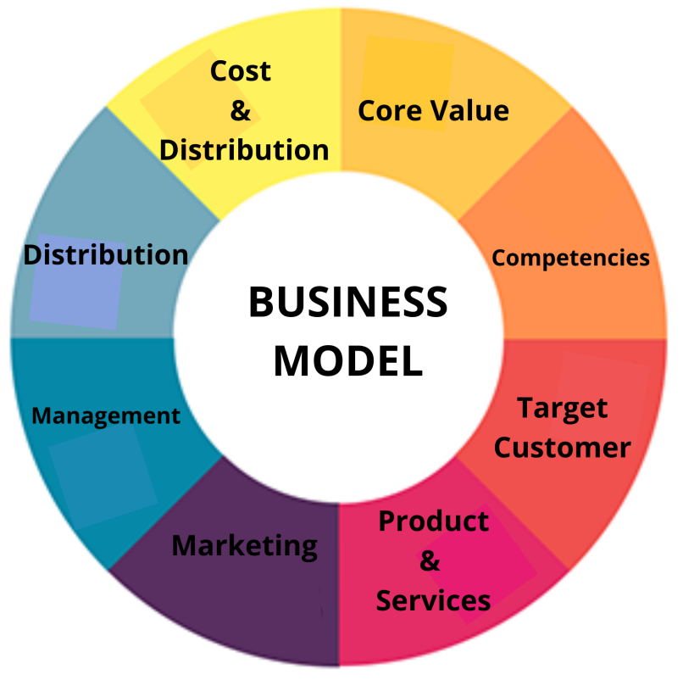
BREAKOUT CONVERSATION QUESTION: Where is the Ethics in Business Modeling?
Boje, D., & Jørgensen, K. M. (2020). A ‘storytelling science’ approach making the eco-business modeling turn. Journal of Business Models, 8(3), 9-26.

Slide 5

Kant → Ethics is Categorical Imperative (Commandments)
Kant → System defined as COGNITIVE (Architectonic)
1. Possibility/ Impossibility
KANT
3. Necessity/ Contingency
2. Existence/ Nonexistence

Slide 6
Hegel→ Disagrees with Kant’s Formula: 3rd category is contributive of 1st & 2nd categories
Hegel’s new theory: History Moves by DIALECTIC Interplay of
3 Contradictory Concepts
1. FORMAL Existence
HEGEL
3. RELATIVE Necessity
2. REAL Possibility

Slide 7
Kierkegaard→ Ethics by Living the Ethical Life
3 Categories from Kant, given Hegel dialectic, with many twists, without Kant’s ordering formula
Possibility/ Impossibility
KIERKEGAARD
Necessity/ Contingency
Existence/ Nonexistence

Slide 8
Kierkegaard→ Ethics by Living the Ethical Life
3 Categories from Kant, given Hegel dialectic, with many twists, without Kant’s ordering formula
Possibility/ Impossibility
BETS on FUTURE NEGATE Past Necessity &/or What is Existential
IRONY IN THE STORYTELLING
BETWEEN
BETWEEN
KIERKEGAARD
Necessity/ Contingency
World History keeps changing order of Life, past/future no longer viable-Necessity
(WORLD HISTORY
Point-of-view
Existence/ Nothing
(Dasein → Tilværelse)
Concrete actuality of Historical EVENTS & FACTS
Changed by BETS on FUTURE or by
HISTORIC
NECESSITY
BETWEEN

Slide 9
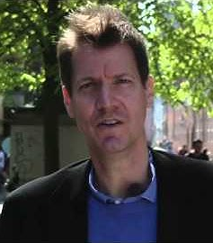
The Life and Work of Kierkegaard as a Socratic task – YouTube Lecture 1 by Jon Stewart recommended
Radical changes occur more rapidly in 21st century. Kierkegaard saw these changes occurring in 19th century
Kierkegaard means by IRONIC; we say opposite of what we really mean, and we can notice this. Uses irony to critique accepted practices (i.e., following Socrates)
Socratic Method is Kierkegaard’s approach to existentialism.
Kierkegaard wrote, “My task is a Socratic task”.
Lecture 2: Kierkegaard, Martensen and Hegelianism at the University of Copenhagen (Show YouTube excerpt) at 21:00.

Slide 10
Caveat: For Kierkegaard & Hegel,
Actuality and Existence are not the same
Life and Actuality are not in Synthesis
in some
SYSTEM LOGIC (Business Model)
I. Immediacy (Existence)
Actuality is a subset of
Life-Existence
II. Mediation
III. Mediated Immediacy

Slide 11
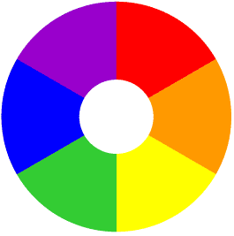
CONVERSATION
6. Take path of Inner Freedom by Inductively Testing Common Sense Making & Universal Claims by Self-Correction
DAIMON
1. Engage all kinds of people in conversational storytelling
5. Show contradictions accepted as True without Critical Reflective Inquiry
Socratic Method
2.Listen to sensemaking of story experiences for understanding
MAIENTICS
CASES
4. Question
Contradictions of their Universal Truth given Existential Particulars in their stories
3. Ask what is Unifying Truth of their story collection
APORIA
TRUTH

Slide 12
BREAKOUT: Use Socratic Method to Explore
Ethics of ‘BUSINESS MODELS”:
Pick any #: Your Own Triadic Relationship among 3 Concepts
Tell a story of a Business Model
Possibility → Existence → Necessity
Possibility → Necessity → Existence
Existence → Possibility → Necessity
Existence → Necessity → Possibility
Necessity → Existence → Possibility
Necessity → Possibility → Existence

Slide 13
Possibility → Existence → Necessity
Possibility → Necessity → Existence
Existence → Possibility → Necessity
Existence → Necessity → Possibility
Necessity → Existence → Possibility
Necessity → Possibility → Existence

Slide 14
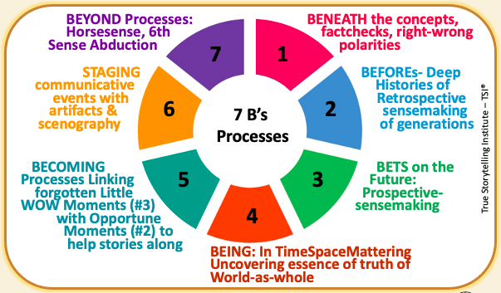
ANTENARRATIVE PROCESSES
Notes:
Stories & Narratives are composed of pre-conceived SURFACE values, concepts, & motives, so GUIDES go BENEATH to core values…
On the surface is the ‘Domination of the Obvious’
Going BENEATH the words, labels, judgements, and polarities, gets to CORE values & CORE concepts & CORE motives
BENEATH the surface is the changes, movements, the flow, and its what is changeless about the world and universe
Going BENEATH the Narrative-Counternarrative arguing, the polarities, we get to the changes and the changeless
What is the BENEATH?
Stories & Narratives are composed of pre-conceived
SURFACE values, concepts, & motives
→ Guides go BENEATH to core values
On the surface is the ‘Domination of the Obvious’
BENEATH the words, labels, judgements, and polarities is the CORE
→ Guides gets to CORE values & CORE concepts & CORE motives
BENEATH the surface is the changes, movements, the flow, and it’s what is changeless about the world and universe
BENEATH the Narrative-Counternarrative arguing, the polarities
→ Guides get to the changes and the changeless

Slide 15
The Two Directions of True Storytelling Processes

Slide 16
Business Modeling does Thesis-Antithesis-Synthesis by Post-Kantian Cognitive Architectonics (aka, Bounded Rationality, missing Existence & its own Negation altogether)
RESULT: A Leap of logic for Business Modeling to reach Existential & impossible Leap to I. Immediacy-Existence or Quantum Leap to go Beyond to II and III.
Thesis-Antithesis-Synthesis
Negation
History Transitions
I. Immediacy
II. Mediation
III. Mediated Immediacy

Slide 17
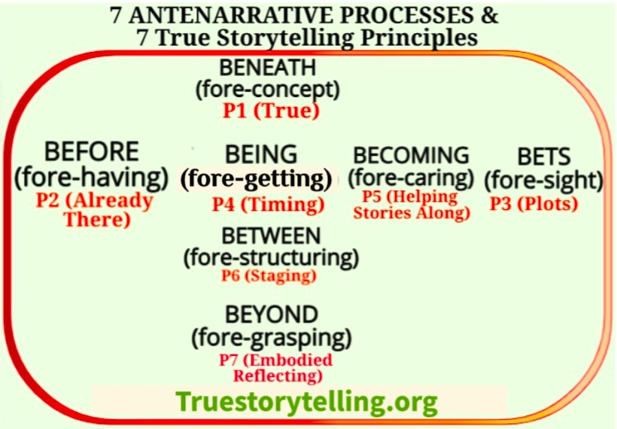
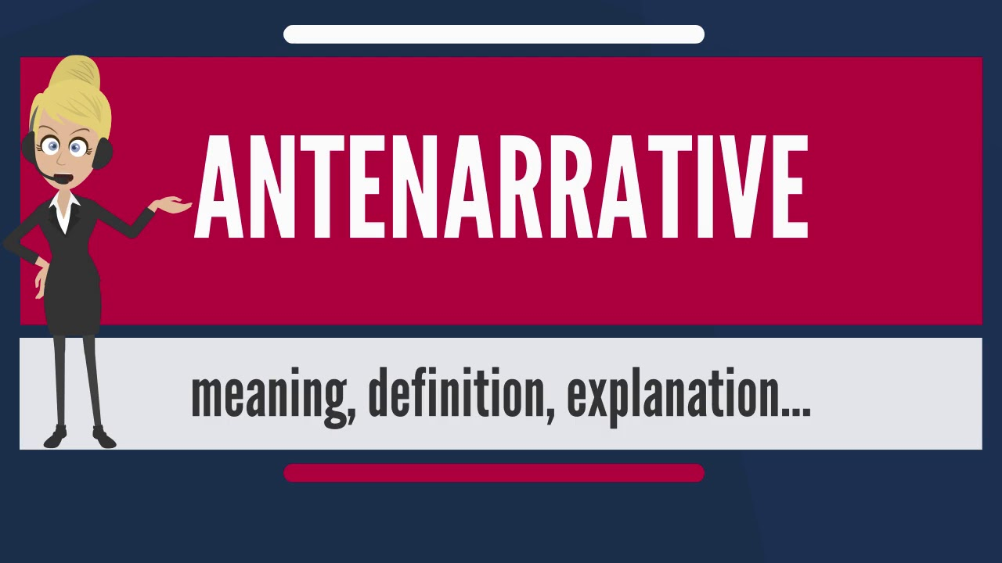

Slide 18
Overview
7 Processes
Notes:
n the Tamara-Land Networking Tool, diagnose how much behavior in the ecology of routines, is programmed by the digital, and how much is human networking (without Materiality dictating the Social). Socialmaterialities are implicated in fractals. And in Tamara-Land of the rooms we work in, storytelling is happening simultaneously. We have tools to understand the theatrics of multiple stages, happening at once, in most every organization. One is about networking. People are networking in the rooms of an organization, in the stairways between rooms, and in the digital ways of communicating within and among networks of organizations, local to global.
Every Organization has its moments of theater, and some are mostly theater. As we move from room to room in an organization we see the visual theater. There are multiplicity of theater room (formal, informal, off and on stage) simultaneous in a TAMARA of sites; with starring and supporting cast of characters who (1) affect the quality of products and services, (2) enhance or lower productivity, and (3) constitute the concentrated and diffuse spectacles of theatrical performances experienced by employees, investors, customers and vendors, and across transorganizational networks.

Slide 19
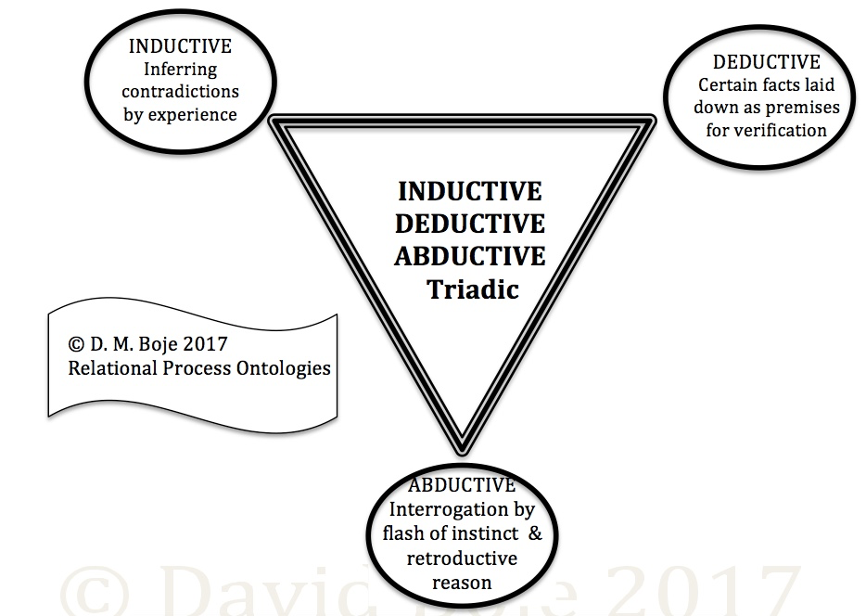

Slide 20
Kierkegaard & Socrates

Slide 21
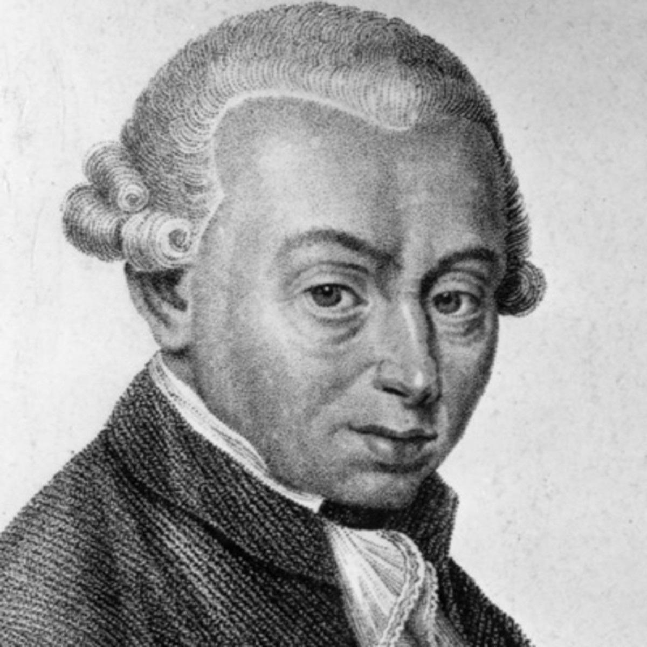
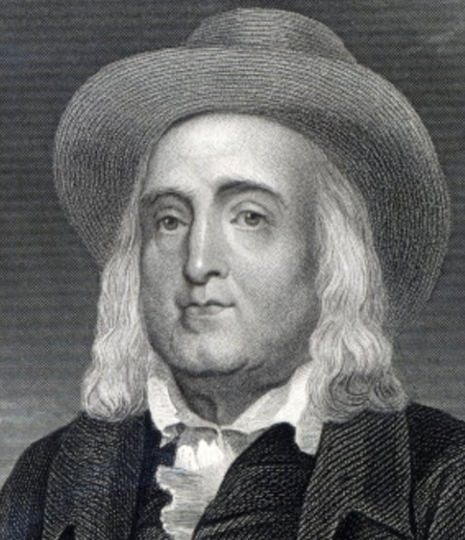
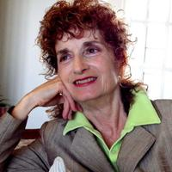
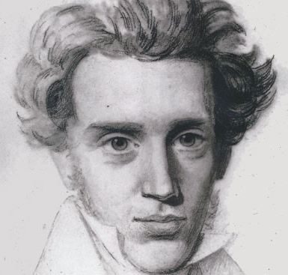
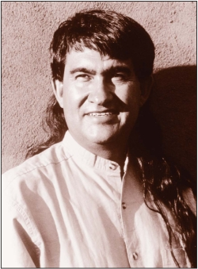
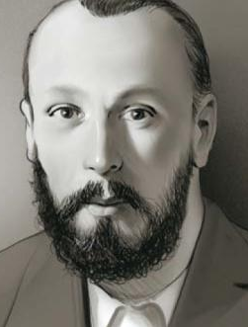
Kant’s Categorical Imperative ethics
(e.g., 10 commandments)
&/or Utilitarian-→Bentham
(morally right = greatest good)
Rosile’s (2016) Indigenous Ways of Knowing
(IWOK, e.g., spiritual ecology [Cajete, 2000])
“Its’ not about living a good life, but a true life [an ethical life]”
Søren Kierkegaard
Danish Philosopher
Bakhtin’s (1920s Moral Answerability
(to not be By-standers)
Notes:
Jeremy Bentham in upper right

Slide 22

Antenarrative & Business Models
QUESTION: I BUSINESS MODELING ‘dangerous’ because the ethics of ‘True Storytelling’ is forgotten, excluded by BOUNDED RATIONALITY
Can we investigate a ‘True Storytelling’ EXISTENTIAL-ethics of the ‘VIRTUAL WATER’ Footprint of Business Models?
WHY? To develop SUSTAINABLE ‘VIRTUAL WATER’ business modeling

Slide 23
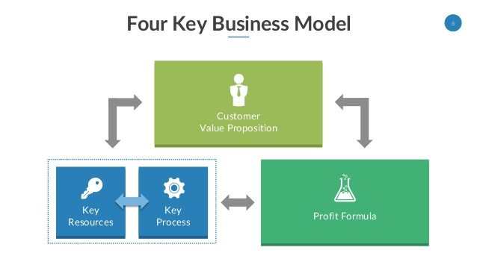
“ ”
Customers
Living Stories
VIRTUAL
Water
Petrified
Narrative
ANTENARRATIVE Process Critique
Notes:
See p. 28 of Mark W. Johnson – Reinvent your Business Model: How to Seize the White Space for Business Growth?

Slide 25
All 7
Antenarrative
Processes

Slide 26
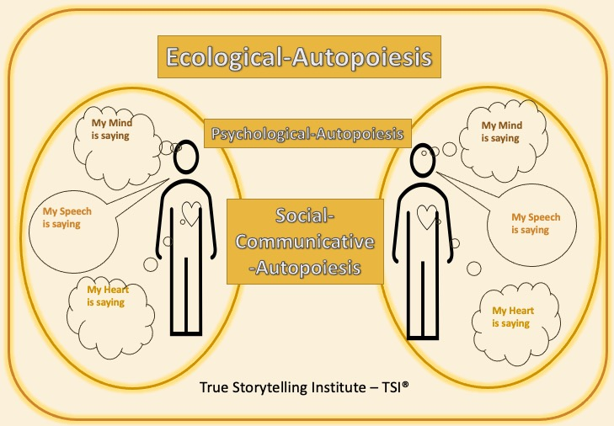
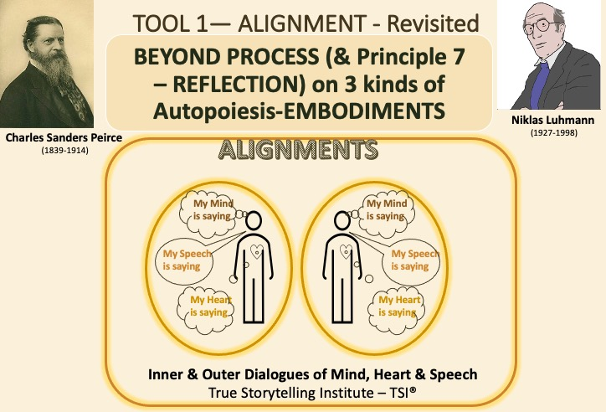


TOOL 1— ALIGNMENT - Revisited
TRUE STORYTELLING™ has
INTEGRATION and WHOLENESS
with head and heart and speech ALIGNED
ALIGNMENTS
My Mind
is saying
My Mind
is saying
My Speech
is saying
My Speech
is saying
My Heart
is saying
My Heart
is saying
Inner & Outer Dialogues of Mind, Heart & Speech
True Storytelling Institute – TSI®
Notes:
To travel back from space and integrate it into our own life. TS is when the are connection between head and heart. SAY MORE ABOUT THAT…..
1.Psychological-Autopoiesis
2.Biological-Autopoiesis
3.Socio—Communicative-Autopoiesis
Brier, Søren (2008). Cybersemiotics: Why Information Is Not Enough!. Toronto: University of Toronto Press

Slide 27
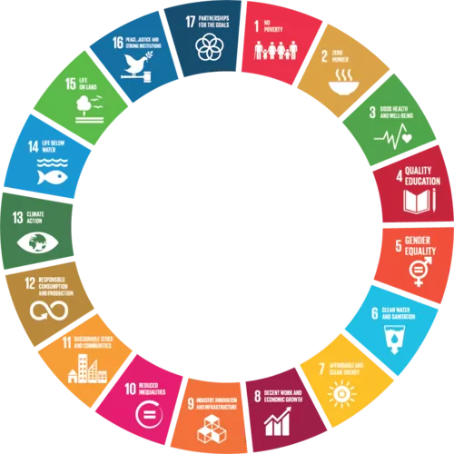
Water Scarcity Affects all 17 United Nations Sustainable Development Goals
https://truestorytelling.org

Slide 28
BREAKOUT CONVERSATIONS
How does BUSINES MODELING relate to 17 SDGs?

Slide 29
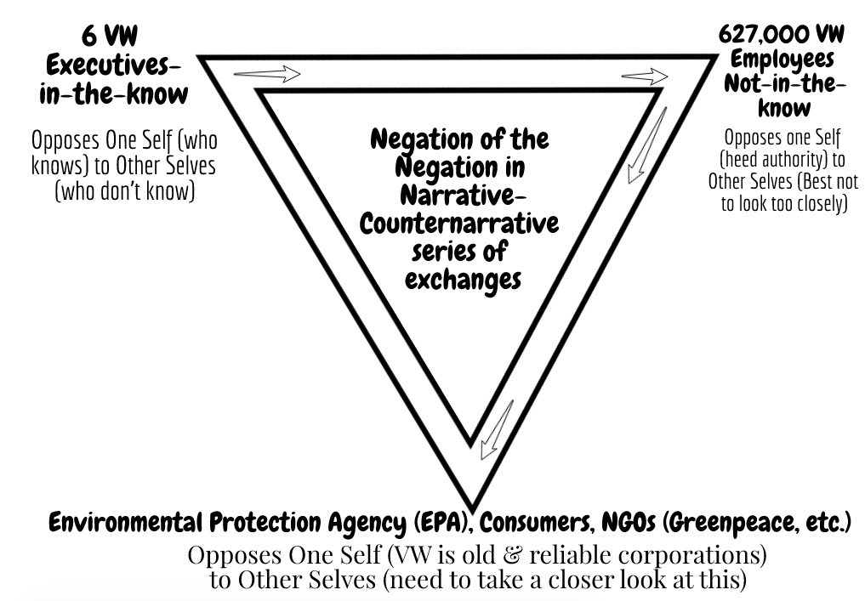
DIESELGATE Defeat Devices
What is True & What is Already There?

Slide 30
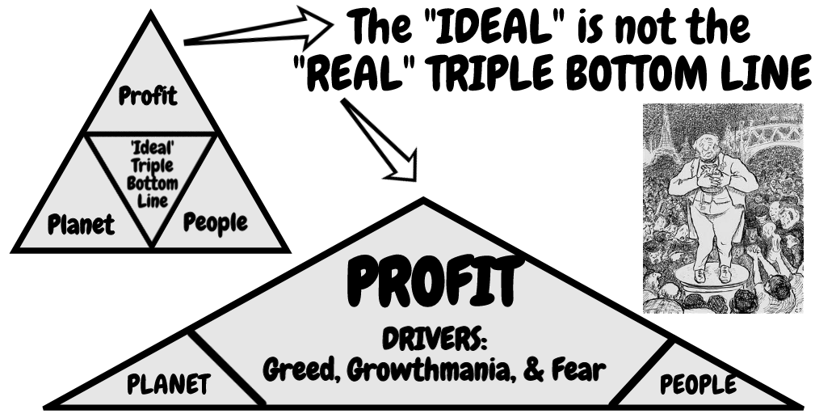
DENY THE DOMINANT PLOT?

Slide 31
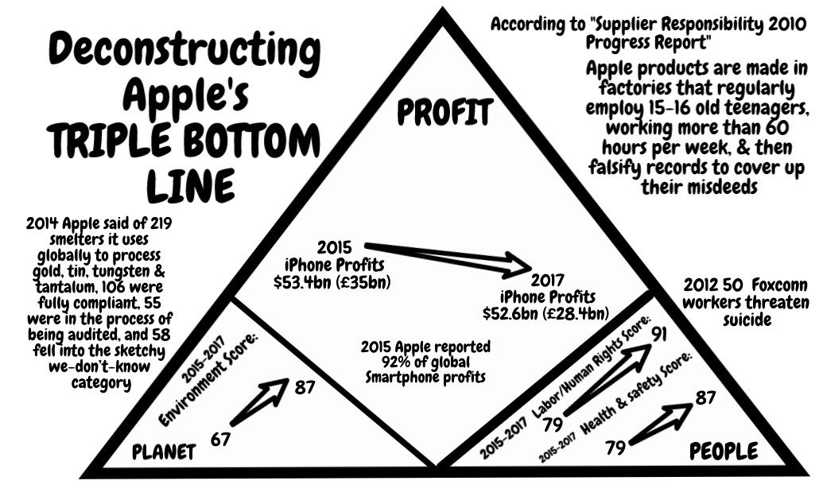

Slide 32
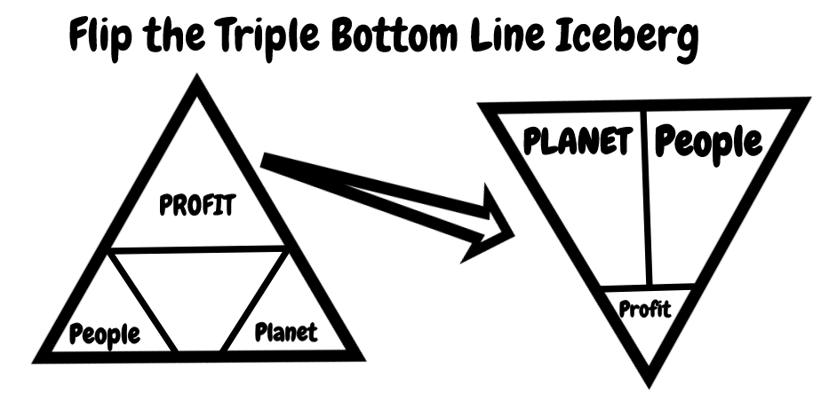
Boje (2019) Storytelling in the global age: There is no Planet B (Vol. 1). World Scientific.
Mogens Sparre and Boje, David M. (2020). Utilizing Participative Action Research With Storytelling Interventions to Create Sustainability in Danish Farming. To appear in Organizational Development Journal. Click here for pre-press pdf

Slide 33
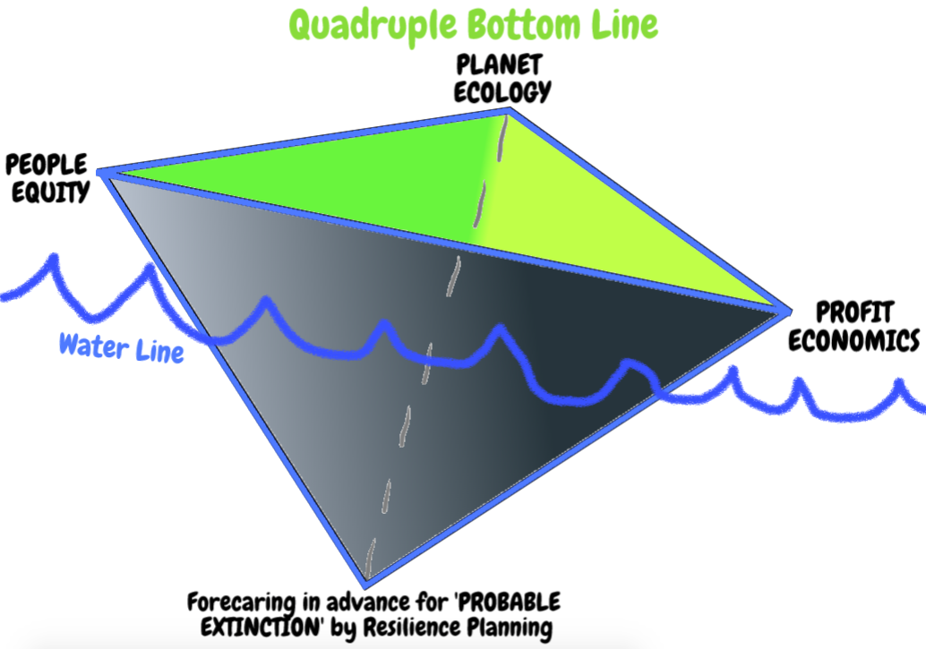
Add an Existential Ethics Dimension (Boje, 2019)

Slide 34
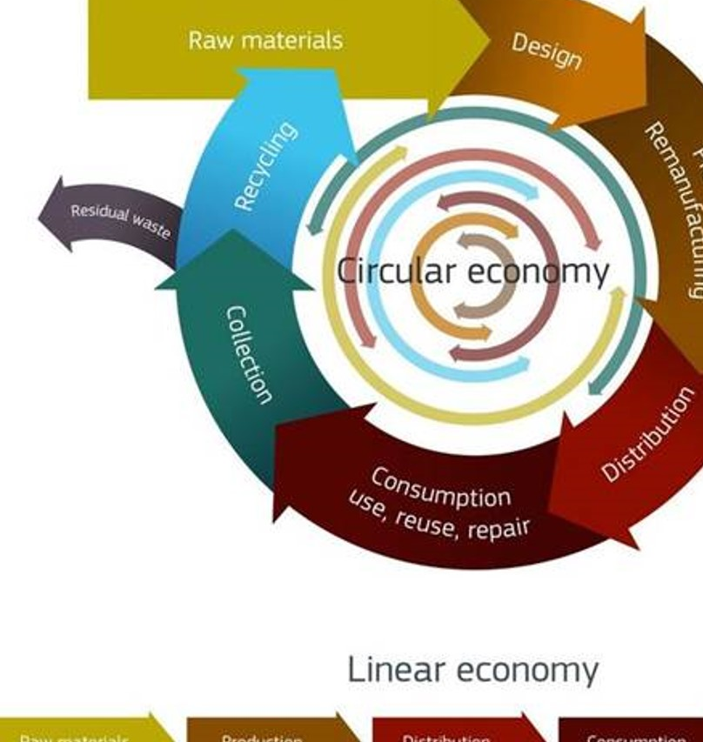
BREAKOUT
QUESTION:
Can you Deconstruct the CIRCULAR ECONOMY?

Slide 35
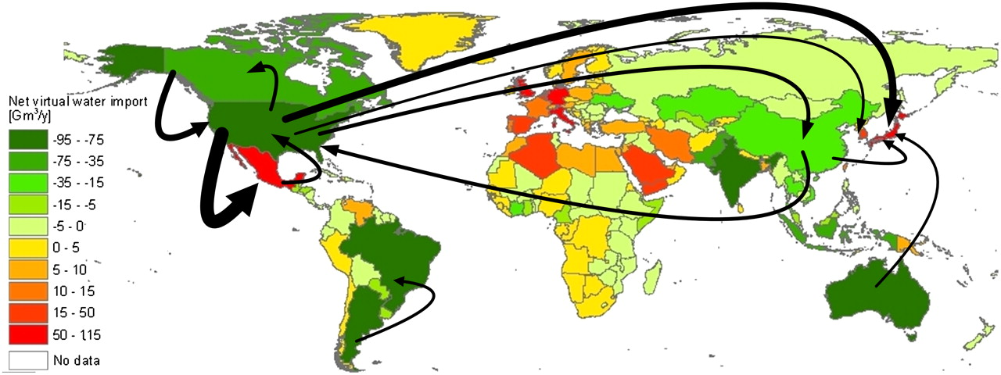

Virtual water balance per country and direction of gross virtual water flows related to trade in agricultural and industrial products over the period 1996–2005.
Arjen Y. Hoekstra, and Mesfin M. Mekonnen PNAS 2012;109:9:3232-3237
©2012 by National Academy of Sciences
Notes:
Virtual water balance per country and direction of gross virtual water flows related to trade in agricultural and industrial products over the period 1996–2005. Only the biggest gross flows (> 15 Gm3/y) are shown. https://waterfootprint.org/en/water-footprint/national-water-footprint/virtual-water-trade/

Slide 36
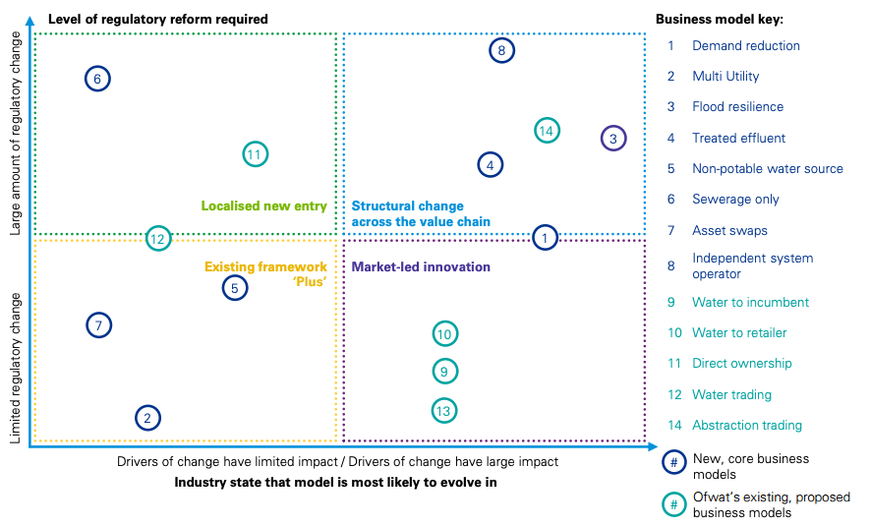
KPMG Water Business Models
13 = Water Trading
Notes:
KPMG Water Business Model Analysis https://stakeholder.affinitywater.co.uk/docs/KPMG%20-Water-sector-business-models.pdf
Affinity Water a UK Company
Promoting groundwater abstraction trading where it moves pressure away from sensitive areas, for example, wetlands and river valleys or coastal areas with saline intrusion risk.
https://gov.wales/sites/default/files/consultations/2018-01/160115-consultation-response-en.pdf
WHAT IS ABSTRACTION TRADING
Summary of proposals:
• Abstractors will receive an annual and daily permitted volume with
similar reliability to now.
• In enhanced catchments, these permitted volumes will be accounted for as proportions or ’shares’ of the water available in different parts of the catchment and any hands off flows will be gradually switched on and off.
Following reform, some groundwater abstractors in enhanced catchments17 will enjoy easier access to water trading due to the establishment of preapproved trading rules.

Slide 37
How to Develop a New BLUE Business Model-Dispositif about Water in Denmark?
Deconstruct UNSUSTAINABLEof PETRIFIED NARRATIVE: BUSINESS MODEL
Critical Accounting of VIRTUAL WATER
Do STORYTELLING SELF-CORRECTING METHOD to reset CORE Values
EXPERIMENTS with BLUE SPACE BUSINESS MODEL
See” REINVENT YOUR BUSINESS MODEL: How to Seize the White Space for Transformative Growth Mark W. Johnson (Boston, MA: Harvard Business Review Press).
Notes:
How to create a ‘[BLUE] Space’ for Business Model-Dispositif Innovation in Caring for Water?
To venture into the White Space, from business’ current operational space, and into ➔ ‘[BLUE] Space’?
Storytelling Relevance? The operational space becomes a ‘petrified narrative’ of strong [core] business culture values (Czarniawska, 2004).
Problem: When new ‘bet on the future’ opportunity appears, the petrified narrative core blocks path to a ‘[BLUE] Space’

Slide 38
Coke’s Business Models
CLICK TO EXPLORE INTERACTIVE VALUE CHAIN

Slide 39
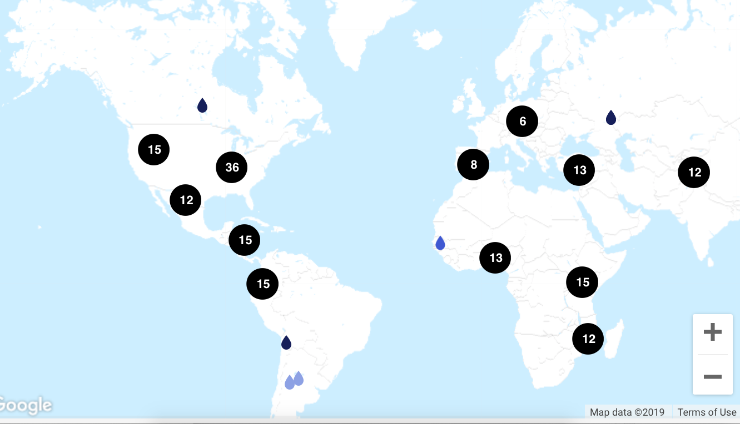
How does Coke Replenish 65.5 billion gallons of Fresh Water?
COCA-COLA’s STORY MAP
# = projects in that location to replenish water used

Slide 40
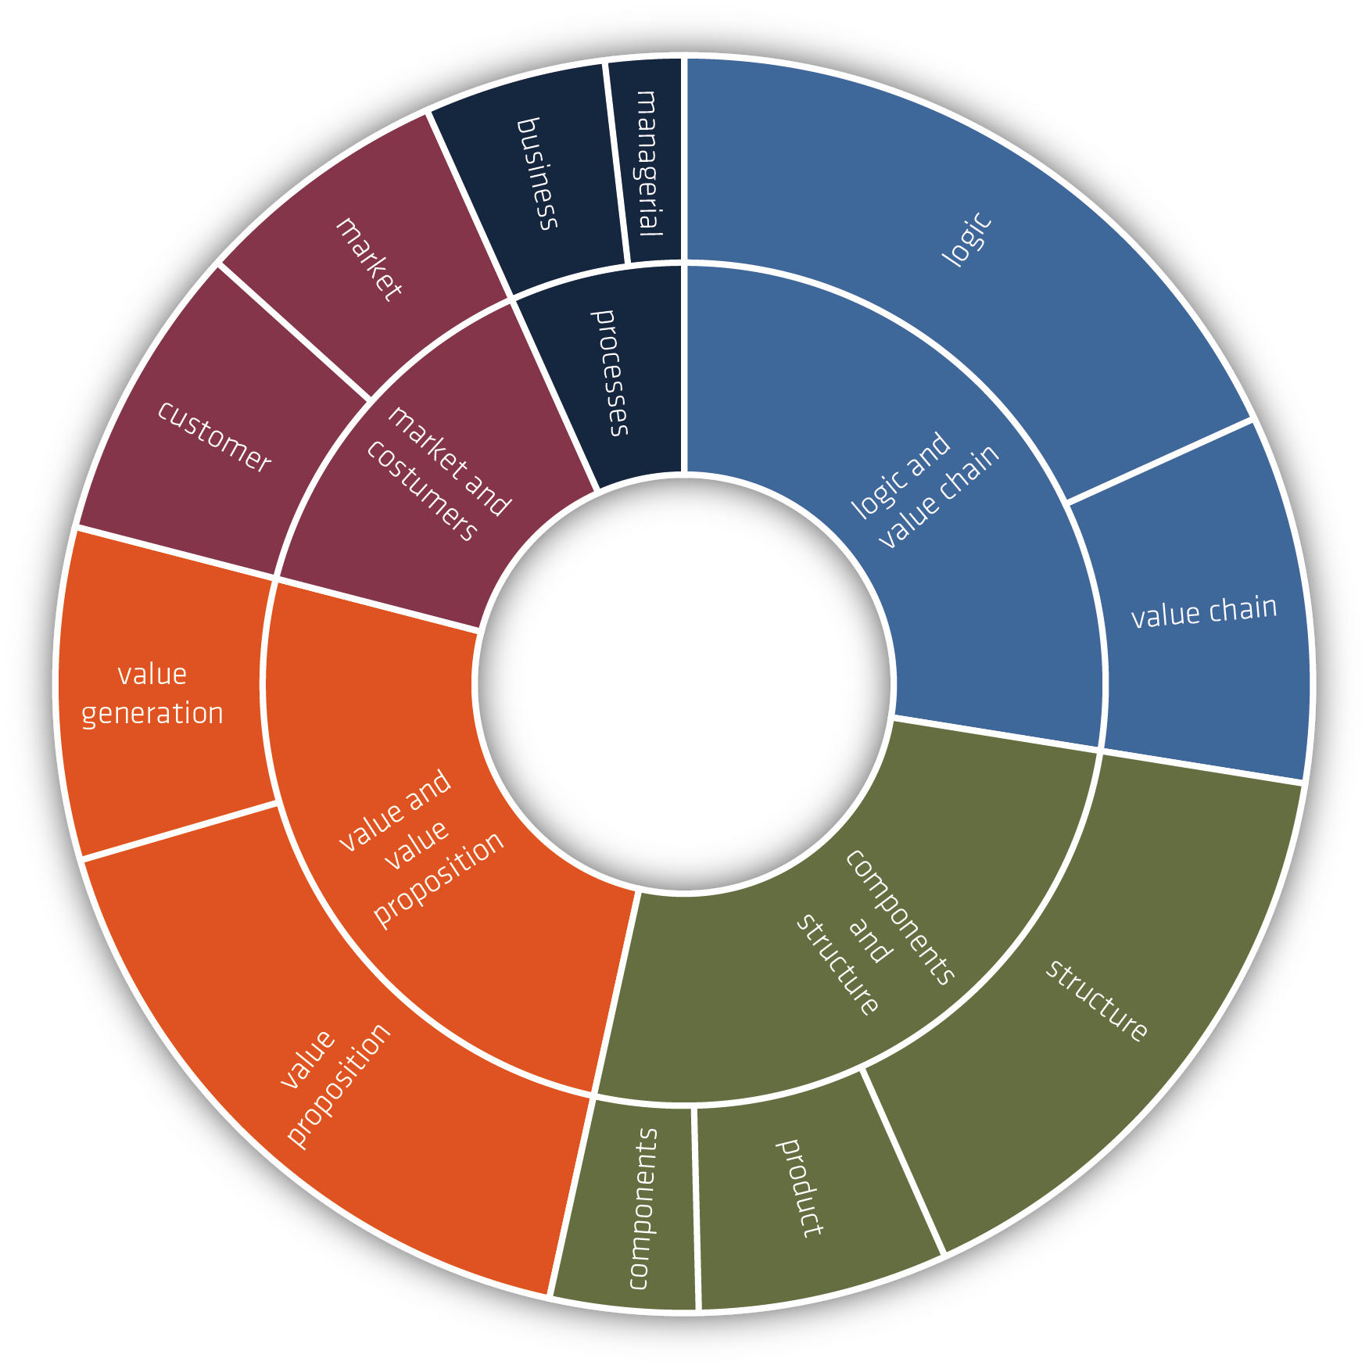
Christian Nielsen, Morten Lund, Marco Montemari, Francesco Paolone, Maurizio Massaro and John Dumay (2019) Business Models

Slide 41
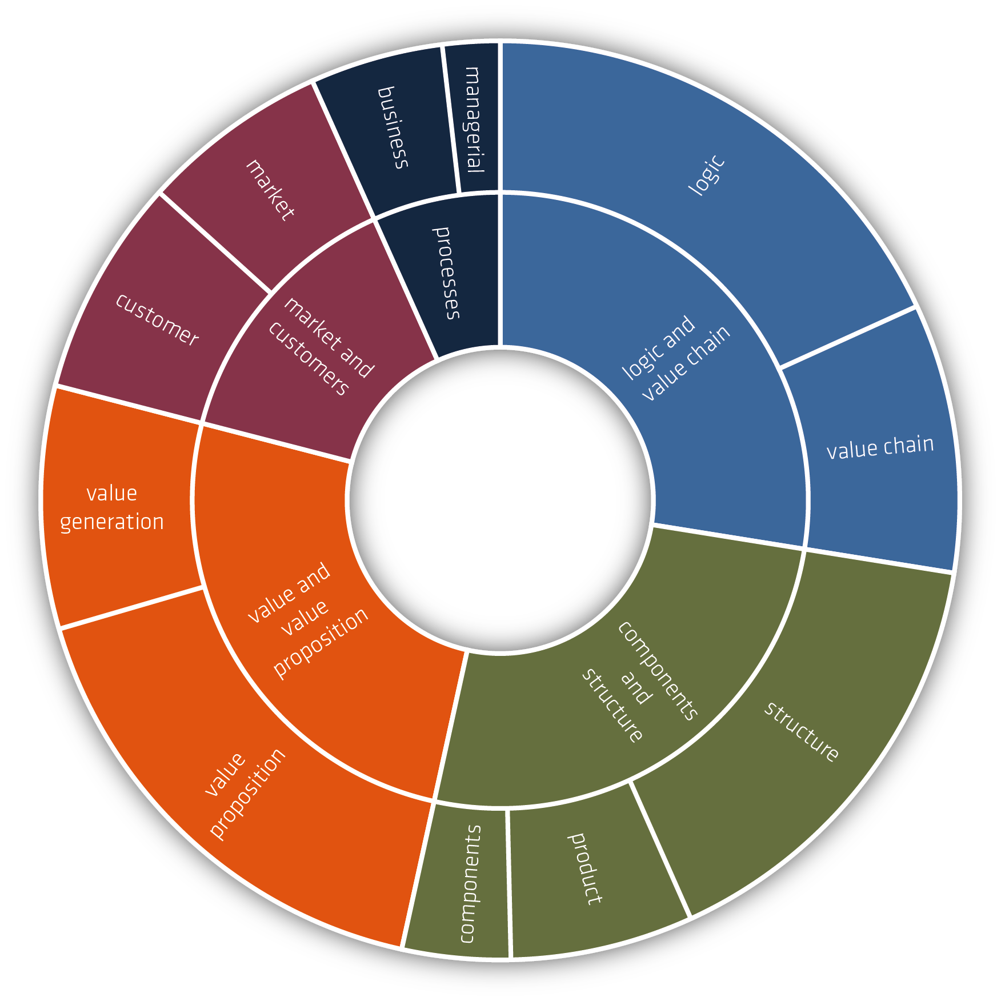
Christian Nielsen, Morten Lund, Marco Montemari, Francesco Paolone, Maurizio Massaro and John Dumay (2019) Business Models

Slide 42
7 B’s of Antenarrative
WATER’s BUSINESS MODEL
example
Before – Water was commodified and privatized the Business Model was WATER=PUBLIC GOOD
Beyond – In EMBODIMENT pre-conscious intuited WATER=LIFE ITSELF in Business Model (taken for granted)
Becoming – Scarcity Business Model (Demand > Supply)
Beneath – Search for conceptions, language, symbols, gestures WATER=PRE-CONCEPTION (1st Mimesis, Ricoeur)
Between – In-between is getting and supplying WATER=INFRASTRCTURE SPACETIMEMATTERING of upstream vs. downstream Business Model (Barad, Strand)
Bets – Multiple ‘Bets On the Future’ WATER=ENSEMBLE OF BUSINESS MODELS along differentiations- value chain players
Being – The essence of Existential Truth of Freedom
Notes:
Before – Water was commodified and privatized in the Business Model, it was WATER=PUBLIC GOOD
Beyond – In EMBODIMENT pre-conscious intuited WATER=LIFE ITSELF
Beneath – Search for conceptions, language, symbols, gestures WATER=PRE-CONCEPTION (1st Mimesis, Ricoeur)
Between – In-between is getting and supplying WATER=INFRASTRCTURE SPACETIMEMATTERING (Barad, Strand)
Bets – Multiple ‘Bets On the Future’ WATER=ENSEMBLE OF BUSINESS MODELS

Slide 43
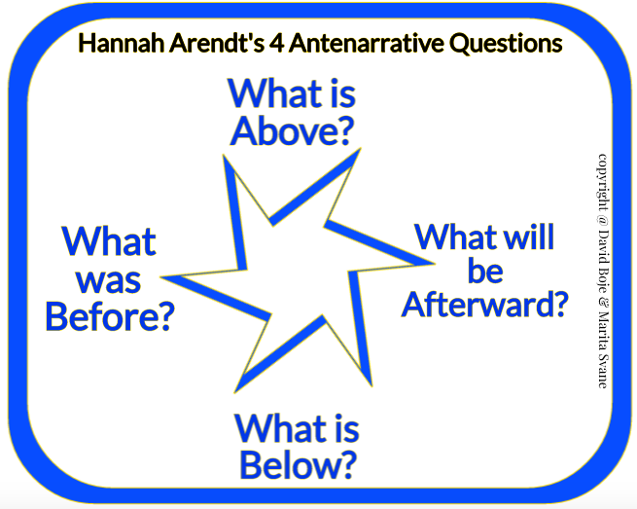

Slide 44
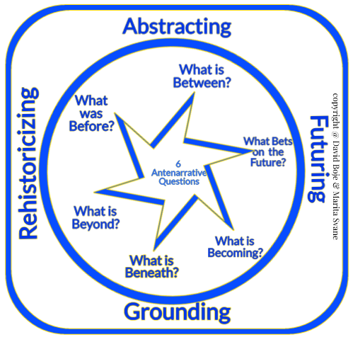

Slide 45
Conclusion:
Water Business Models and Business Storytelling are Entangled
Notes:
p. 28 https://stakeholder.affinitywater.co.uk/docs/KPMG%20-Water-sector-business-models.pdf
Affinity Water was established through the purchase of Veolia Water's UK water supply operations by Rift Acquisitions, an entity established by Morgan Stanley and M&G Investments, for £1.2 billion on 28 June 2012. Wikipedia
Self-Correcting Storytelling Methodology is about testing and experimenting to get new ‘bets on the future’
Bocken, N., Boons, F., & Baldassarre, B. (2019). Sustainable business model experimentation by understanding ecologies of business models. Journal of Cleaner Production, 208, 1498-1512.
Boons, F., & Laasch, O. (2019). Business models for sustainable development: a process perspective. Journal of Business Models, 7(1), 9-12.
Joyce, A., & Paquin, R. L. (2016). The triple layered business model canvas: A tool to design more sustainable business models. Journal of Cleaner Production, 135, 1474-1486.
Lüdeke-Freund, F., Bohnsack, R., Breuer, H., & Massa, L. (2019). Research on Sustainable Business Model Patterns: Status quo, Methodological Issues, and a Research Agenda. In Sustainable Business Models (pp. 25-60). Palgrave Macmillan, Cham.
Schaltegger, S., Hansen, E. G., & Lüdeke-Freund, F. (2016). Business models for sustainability: Origins, present research, and future avenues.

Slide 46
CONCLUSION: Develop TERRESTRIAL ETHICS WATER BUSINESS PLAN or our grandchildren will be the BET ON THE FUTURE THAT WILL NEVER BE
Notes:
Self-Correcting Storytelling Methodology is about testing and experimenting to get new ‘bets on the future’
Bocken, N., Boons, F., & Baldassarre, B. (2019). Sustainable business model experimentation by understanding ecologies of business models. Journal of Cleaner Production, 208, 1498-1512.
Boons, F., & Laasch, O. (2019). Business models for sustainable development: a process perspective. Journal of Business Models, 7(1), 9-12.
Joyce, A., & Paquin, R. L. (2016). The triple layered business model canvas: A tool to design more sustainable business models. Journal of Cleaner Production, 135, 1474-1486.
Lüdeke-Freund, F., Bohnsack, R., Breuer, H., & Massa, L. (2019). Research on Sustainable Business Model Patterns: Status quo, Methodological Issues, and a Research Agenda. In Sustainable Business Models (pp. 25-60). Palgrave Macmillan, Cham.
Schaltegger, S., Hansen, E. G., & Lüdeke-Freund, F. (2016). Business models for sustainability: Origins, present research, and future avenues.

Slide 47
Articles to Transform Business Modeling
Slides are at https://antenarrative.com
Boje, David M.; Jorgensen, Kenneth Mølbjerg. (2020). A ‘storytelling science’ approach making the eco-business modeling turn. Journal of Business Modeling, Vol. 8, No. 4, pp. 8-25. Click here for pre-press pdf. Please Click here for final print version PDF
Boje, David M.; Rana, Mohammad B. (2020). Defining a Sustainably-Driven Business Modeling Strategy with a ‘Storytelling Science’ Approach. Chapter to appear in Markovic, S., Sancha, C. and Lindgreen, A. (Eds.), Handbook of Sustainability-driven Business Strategies in Practice, Northampton, MA: Edward Elgar. Click here for pre-press pdf.
Mogens Sparre and Boje, David M. (2020). Utilizing Participative Action Research With Storytelling Interventions to Create Sustainability in Danish Farming. To appear in Organizational Development Journal. Click here for pre-press pdf.
Jørgensen, Kenneth Mølbjerg; Boje, David M. Storytelling Sustainability in Problem-Based
Learning. Chapter to appear. Click here for pre-press pdf.
Rosile, Grace Ann; Boje, David M; Herder Richard A.; Sanchez, Mabel. (2021). The Coalition of Immokalee Workers Uses Ensemble Storytelling Processes to Overcome Enslavement in Corporate Supply Chains. Business and Society. Business & Society, Vol. 60(2) 376–414. Click here fore pre-press pdf.
more at Antenarrative.Com

